Slide 1
AMA PERIODONTAL TEST (bana type method)
An express, chair-side test for rapid detection of the «red complex» bacteria associated with inflammatory periodontal diseases
HEXAGON INTERNATIONAL (GB) LTD Telephone ENGLAND ( 44 ) 1442 871710 E-mail info@HexagonLimited.com

Slide 2
AMA PERIODONTAL TEST
APPLICATIONS
assisting the dental professional in establishing the presence of the 3 red complex bacteria - B.Forsythus, T. Denticola, P. Gingivalis which in concentration can indicate the presence of periodontal disease and, in some cases, of halitosis (when the cause is perio disease) . This evidence can also be shown to the patient to explain the necessity of treatment.
HEXAGON INTERNATIONAL (GB) LTD

Slide 3
AMA PERIODONTAL TEST
APPLICATIONS
for healthcare professionals to monitor progress in a course of perio disease treatment, such as deep cleaning, root planing, antibiotic treatment by the dentist, or the hygienist .
HEXAGON INTERNATIONAL (GB) LTD

Slide 4
AMA PERIODONTAL TEST
APPLICATIONS
for dentists practising implant work, to assess perio infection, particularly in pre- and post-op settings.
HEXAGON INTERNATIONAL (GB) LTD

Slide 5
AMA PERIODONTAL TEST
APPLICATIONS
For use in research and post-grad studies in this important area of dentistry research where increasingly clinical investigations appear to implicate the perio disease bacteria in wider systemic problems in the body ( such as heart disease, some cancers, pre-term births, etc. )
HEXAGON INTERNATIONAL (GB) LTD

Slide 6
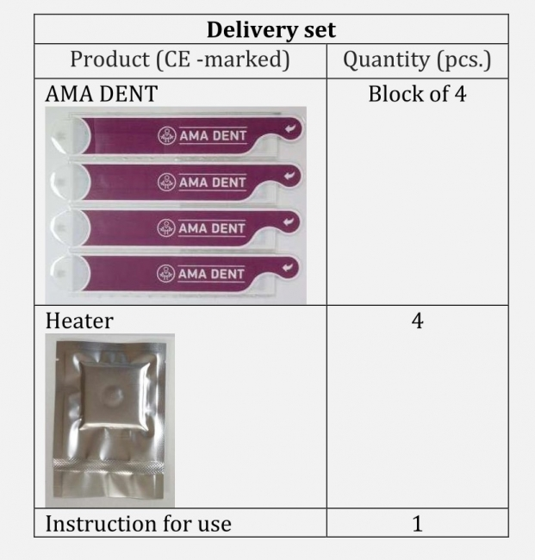
AMA PERIODONTAL TEST
TEST KIT SET
HEXAGON INTERNATIONAL (GB) LTD

